Slide 1

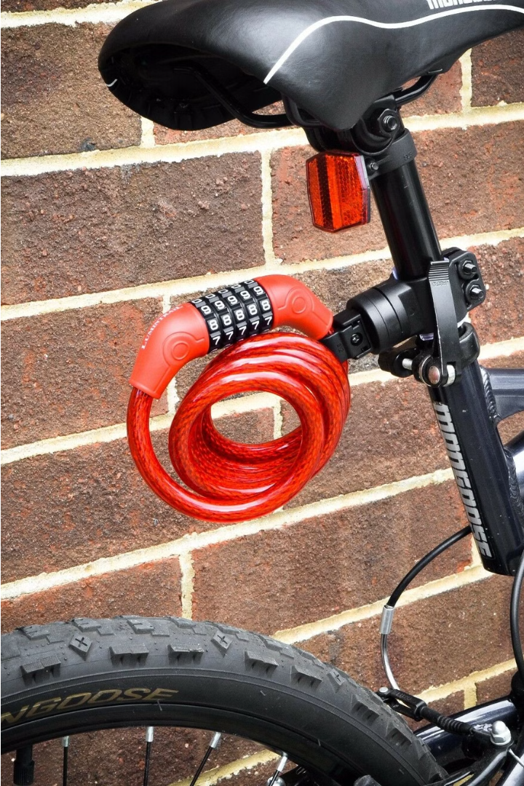
Smart Bike Lock System: Stopping Bikes When Alcohol is Detected
BY
DIVYA SRI S J (210701057)
GANESH P (210701059)
GAYATHRI PRIYA J (210701060)

Slide 2
Problem Statement
The persistent threat of alcohol-impaired driving poses a formidable challenge to road safety efforts worldwide. Despite widespread awareness of the dangers and legislative measures to deter drunk driving, the problem persists, resulting in countless tragedies each year. Traditional methods of enforcement and education have had limited success in curbing this behavior, underscoring the need for innovative solutions that address the root cause of the issue.
The proposed automated vehicle alcohol detection system aims to fill this gap by leveraging IoT sensors to detect alcohol presence and initiate preventive measures to stop the vehicle. However, several challenges must be addressed to ensure the effectiveness, reliability, and ethical implications of such a system. These include technological limitations, regulatory considerations, privacy concerns, and public acceptance. This paper seeks to explore these challenges in-depth and propose strategies for overcoming them to advance the goal of reducing alcohol-related accidents and saving lives on the road.

Slide 3

Abstract
This project stands as a beacon of innovation in the realm of road safety, offering a comprehensive solution to the persistent threat of drunk driving. Leveraging the precision of an MQ3 sensor, the system efficiently identifies the presence of alcohol in its surroundings. This sensor's output, calibrated to alcohol concentration, is swiftly processed by an Arduino microcontroller. Upon surpassing a predetermined threshold, the Arduino triggers the engine lock mechanism, effectively immobilizing the vehicle and thwarting any attempt at operation. In tandem with this crucial functionality, a red LED indicator is activated to warn nearby vehicles when the distance becomes perilously close, ensuring heightened situational awareness. This holistic approach aims to significantly reduce the incidence of accidents caused by alcohol-impaired drivers, thereby safeguarding lives and preserving the integrity of our roadways. The algorithm involves signal processing, calibration, and setting thresholds to trigger alerts when alcohol levels exceed predefined limits. Data logging and user interfaces enhance user interaction and facilitate data analysis. Integration with IoT platforms enables remote monitoring and control. Rigorous testing ensures the system's reliability and accuracy under various conditions. Overall, the alcohol detection system provides an effective solution for mitigating alcohol-related risks, promoting safety, and safeguarding individuals and communities. Its versatility and scalability make it suitable for diverse applications, contributing to a proactive approach in ensuring safety in different environments.

Slide 4
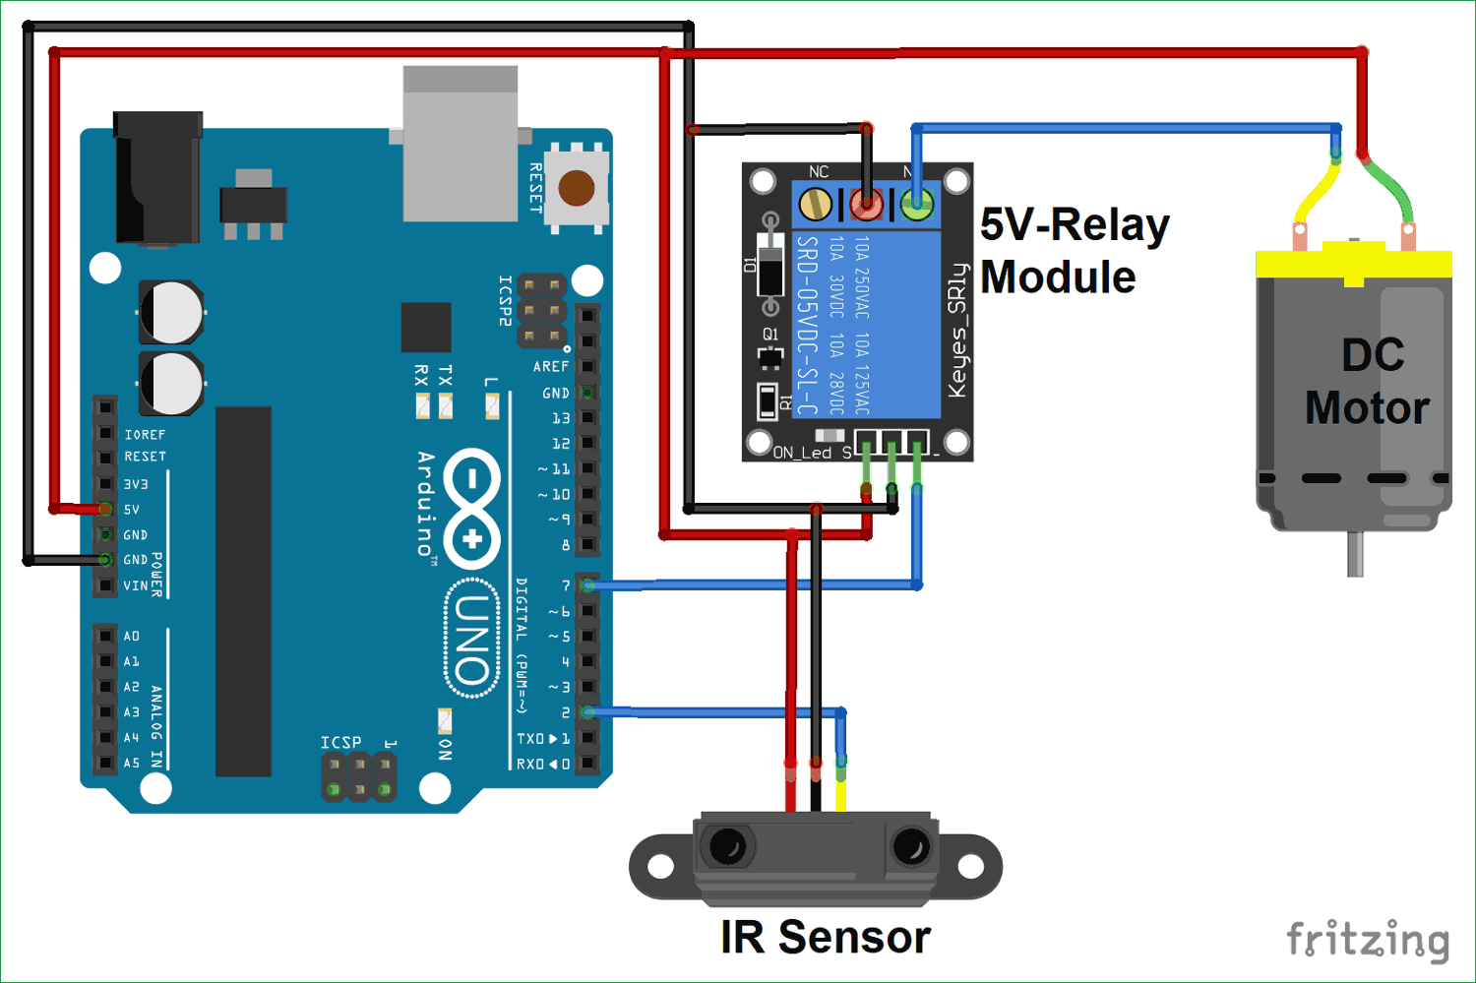
System ARCHITECTURE

Slide 5
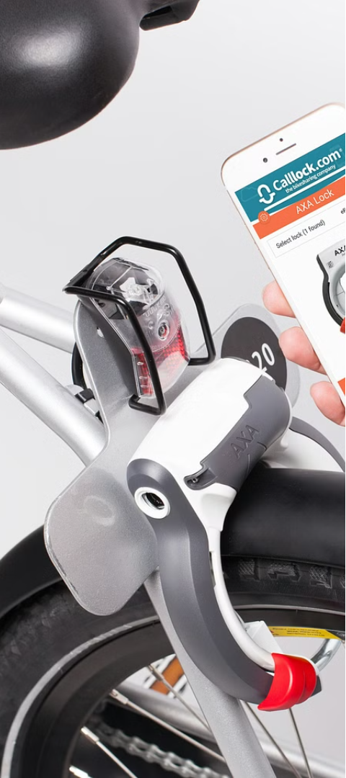
Proposed System
1
Alcohol Sensor
The smart bike lock system incorporates an alcohol sensor that can detect the presence of alcohol on the rider's breath.
2
Lock Activation
If alcohol is detected, the system automatically locks the bike, preventing it from being ridden by the impaired individual.
3
Unlocking with Sobriety
The bike can only be unlocked once the rider's sobriety is confirmed, ensuring the safety of the rider and others on the road.

Slide 6
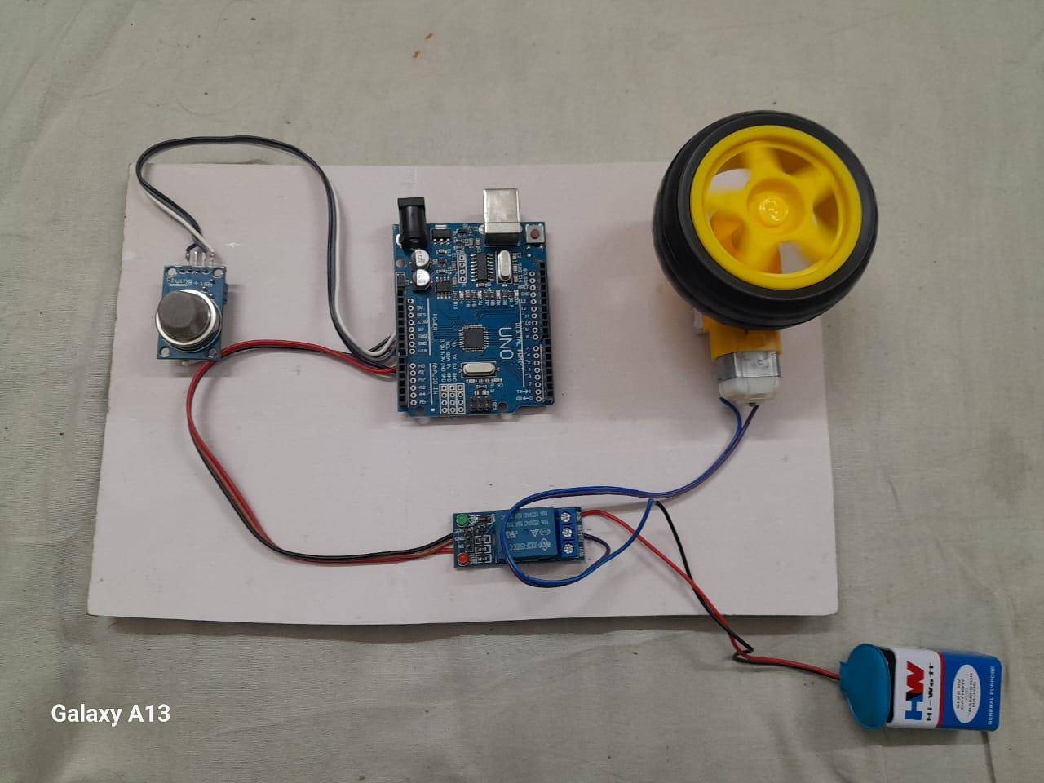
OUTPUT:

Slide 7
REQUIREMENT SPECIFICATION:
HARDWARE SPECIFICATION
Arduino UNO
MPQ3 Sensor
Relay
Battery
SOFTWARE SPECIFICATION
Arduino IDE
Windows 11

Slide 8




Future Enhancements
GPS Tracking
Wireless Connectivity
Mobile App Integration
Solar Power
Integrate GPS functionality to track the bike's location and alert owners in case of theft.
Incorporate solar panels to recharge the lock's battery and ensure continuous, sustainable operation.
Enable wireless communication to allow remote monitoring and control of the lock system.
Develop a comprehensive mobile app for seamless user interaction and management of the lock system.

Slide 9
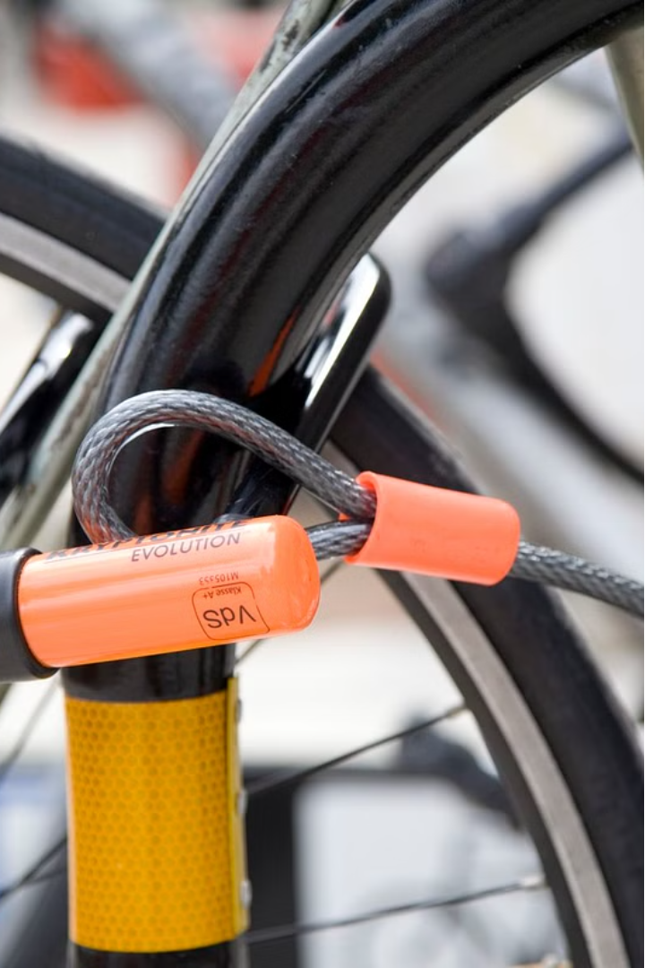
Conclusion
The proposed smart bike lock system offers a innovative solution to enhance bicycle security and safety by preventing drunk riding. Through its alcohol detection capabilities and automated locking mechanism, this system aims to significantly reduce the risks of bike theft and impaired cycling incidents.

